Slide 1
IOT BASED SMART RENEWABLE ENERGY
GENERATION & IRRIGATION SYSTEM WITH
MOISTURE DETECTION
Author : RANJAN KUMAR

Slide 2



Content
Introduction Objectives Motivation Literature survey
Project work description
Block Diagram & Circuit diagram Hardware Components
Software Used Flow chart Results Conclusion Future Scope References

Slide 3

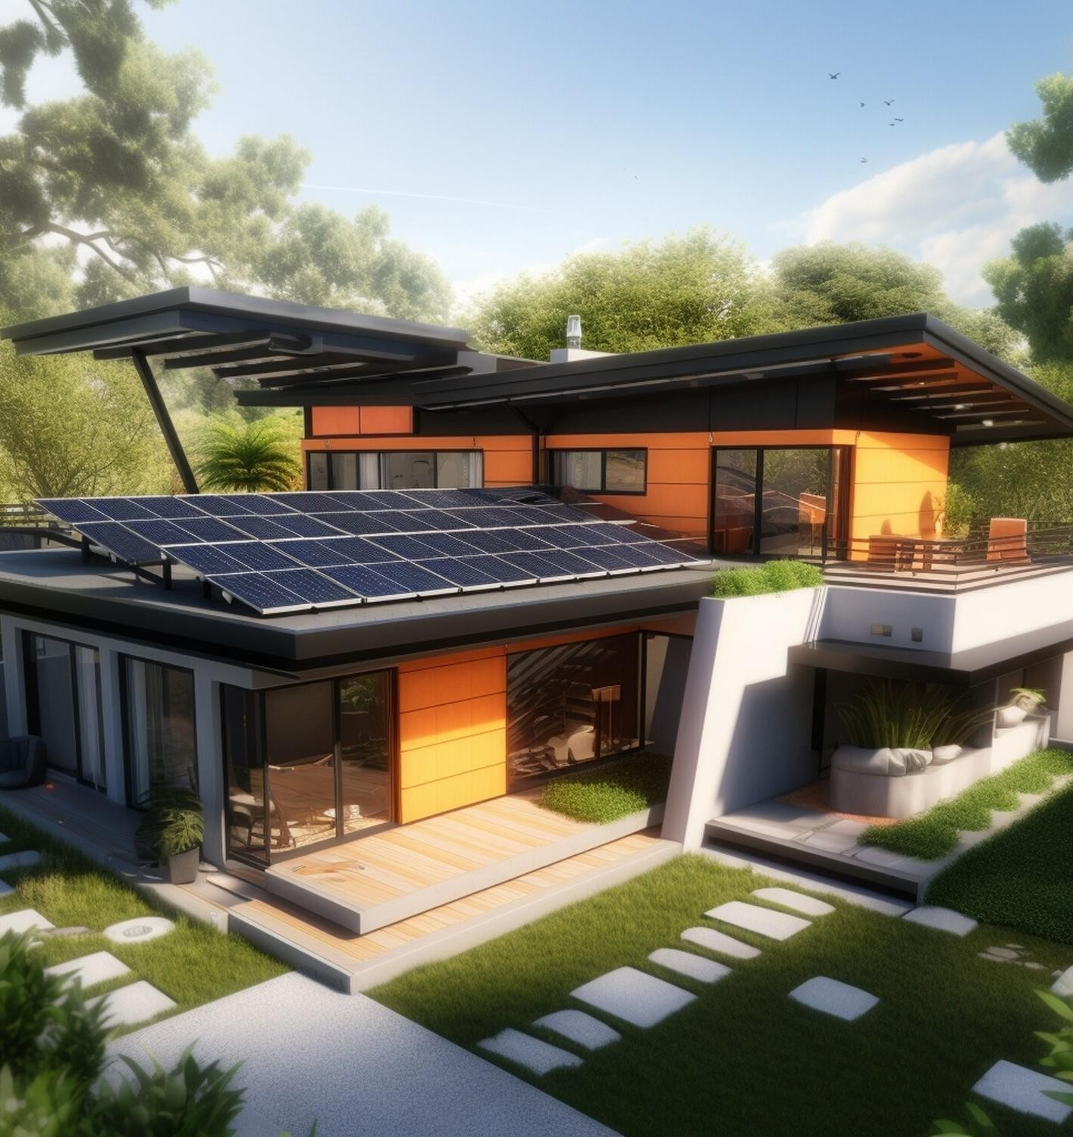
INTRODUCTION
The
IoT-based Smart Renewable Energy Generation & Irrigation System with Moisture Detection is an innovative solution that integrates Internet of Things
(IoT) technology to enhance agricultural practices. This system combines renewable energy sources, such as solar or
wind power, with intelligent
irrigation management and moisture detection capabilities.

Slide 4
OBJECTIVES
•Develop an IoT-based system that combines renewable energy
sources with intelligent irrigation management
Implement sensors for real-time monitoring of soil moisture levels, allowing for data-driven irrigation
decisions
Integrate renewable energy sources such as solar and wind power to provide a sustainable and eco-friendly energy
supply.
Design a user-friendly interface for remote monitoring and control of the entire system

Slide 5

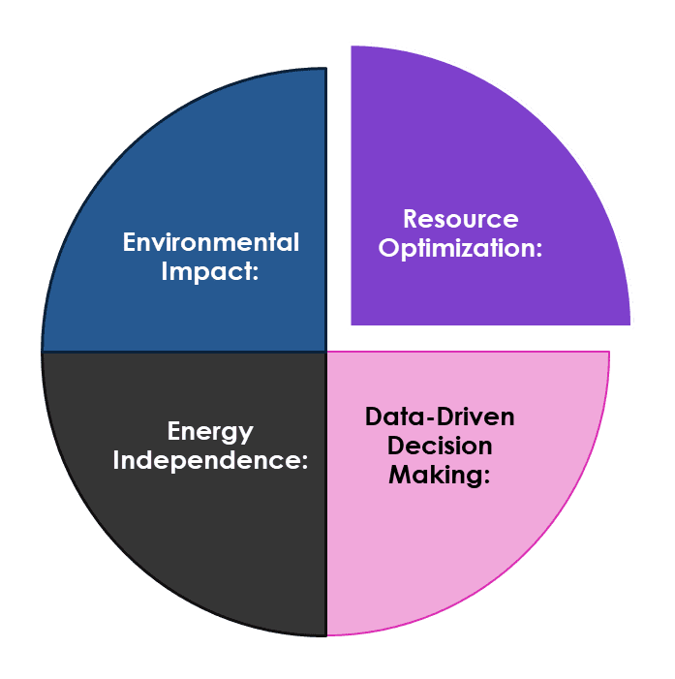
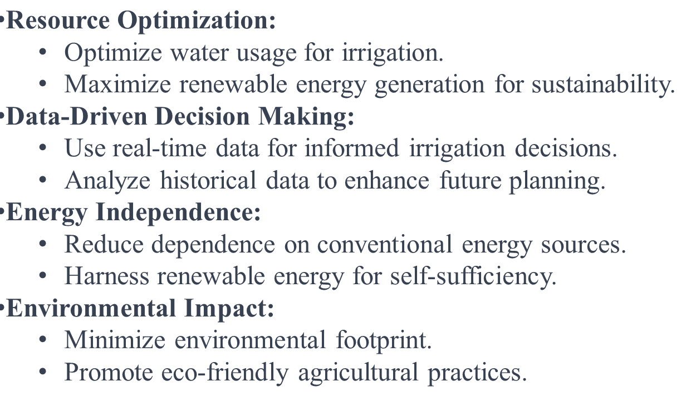
MOTIVATION

Slide 6
LITERATURE SURVEY
Authors : Shweta B. Saraf, Dhanashri H. Gawali
Published by : IJRASET DOP : 25-02-2022
Authors : Moinak Bose, Sourodip Ghosh Published by : IRJET
DOP : 25-03-2020

Slide 7
PROJECT WORK DESCRIPTION
´The IoT-based
Smart Renewable Energy Generation & Irrigation System with Moisture
Detection is a pioneering project that seamlessly integrates renewable energy
sources and advanced irrigation techniques. Utilizing Internet of Things
(IoT)
technology, the system optimizes energy generation from renewable sources like
solar and wind, ensuring sustainable power for irrigation. Real- time moisture
detection enables efficient water management, ensuring precise irrigation based
on soil moisture levels. This smart system enhances agricultural productivity,
reduces energy dependency, and promotes environmental sustainability by harnessing clean energy and optimizing water usage through intelligent monitoring and control mechanisms.

Slide 8
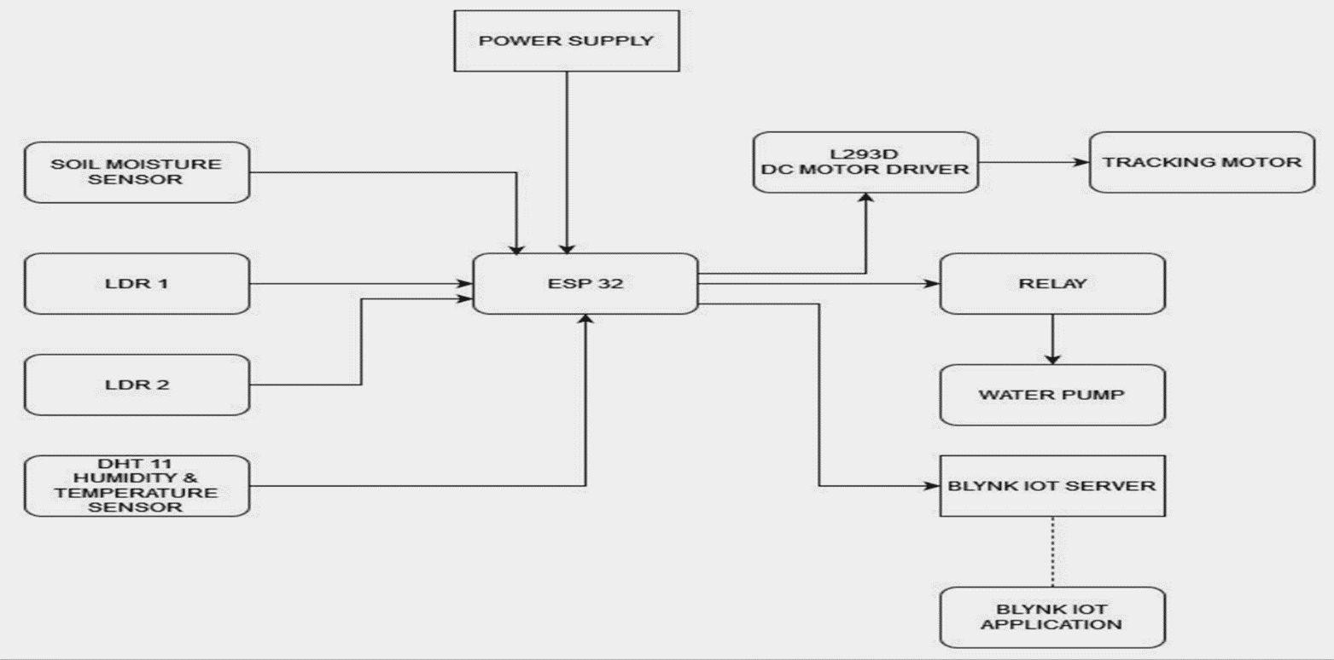
BLOCK DIAGRAM

Slide 9
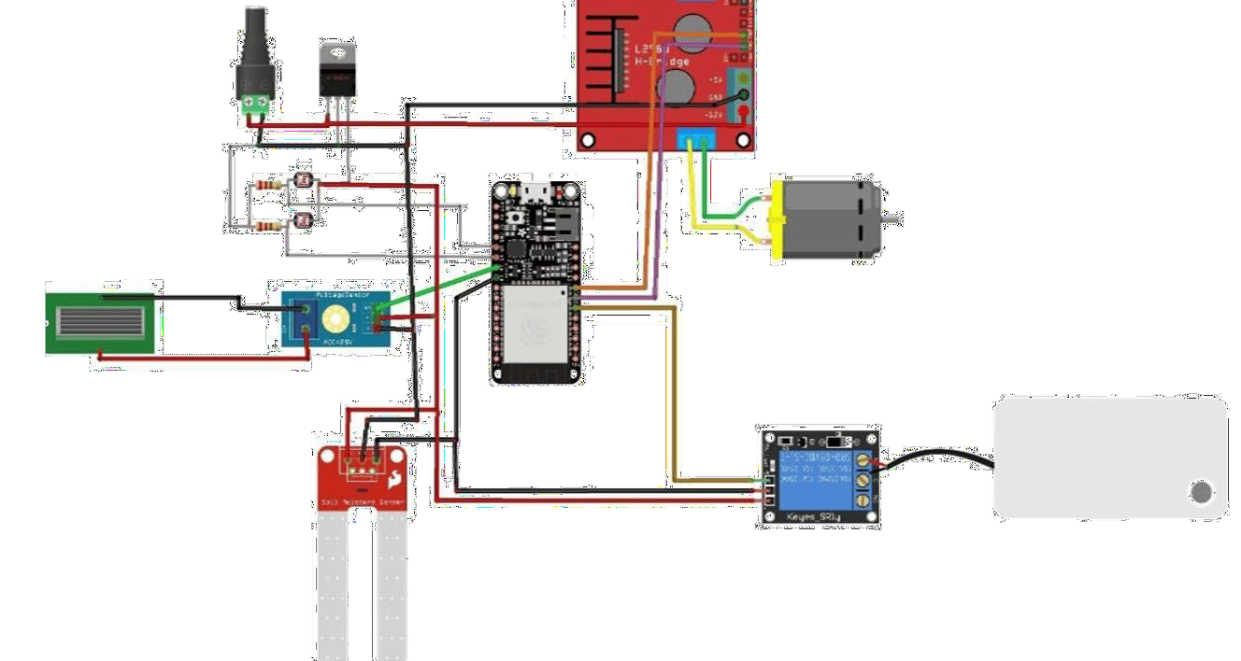
CIRCUIT DIAGRAM

Slide 10
HARDWARE COMPONENTS
ESP 32
Solar Panel L293D
LDR Sensor
LDR Module
Soil Moisture Sensor
Soil Moisture Module ACS712 Current Sensor Voltage Sensor
DHT 11
Relay Module DC Motor
Transistor Capacitor
Resistor

Slide 11

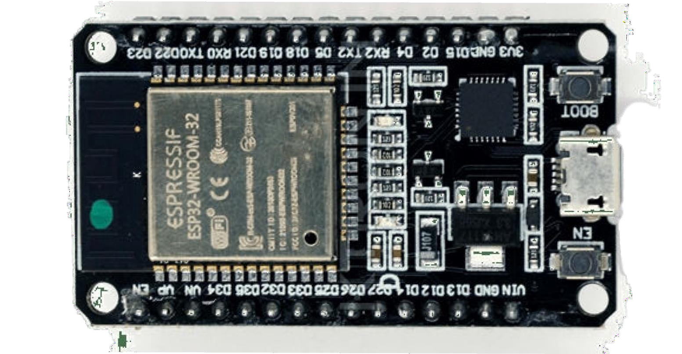
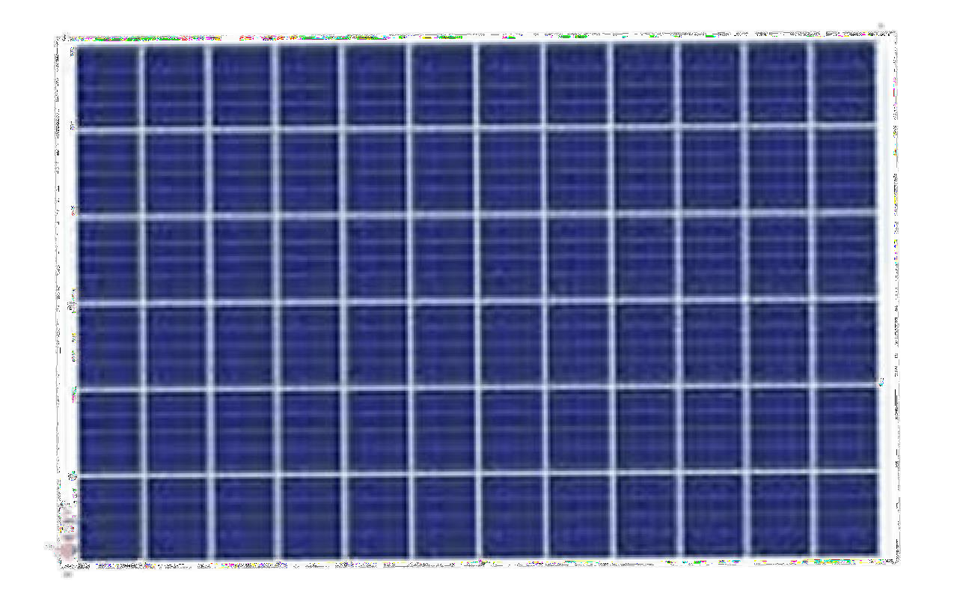
ESP 32
SOLAR PANEL
•The ESP32 is a powerful, low-cost
Solar panels, also known as photovoltaic (PV) panels, are devices that
convert sunlight into electricity.
microcontroller Systems.
It
developed by Espressif
integrates Wi-Fi and Bluetooth
capabilities,
making it suitable for IoT (Internet of Things) applications.

Slide 12
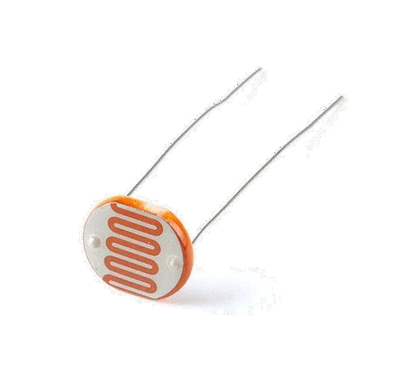
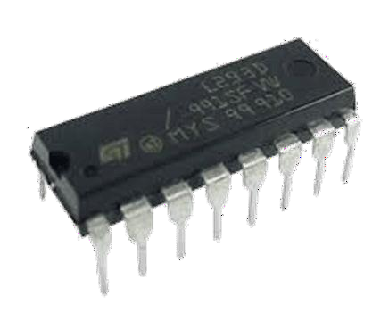
L293 D
LDR
The
L293D is a dual H-bridge motor driver IC that facilitates bidirectional control
of DC motors. It enables seamless interfacing
with sensors and
microcontrollers, making it a versatile choice for various robotic and
electronic applications. The IC's built-in
protection ensures reliability in motor control circuits.
The
Light Dependent Resistor (LDR) is a passive electronic component that exhibits
a change in resistance based on the intensity of
light it is exposed to. Widely
used in light-sensing applications, LDRs find applications in automatic
lighting systems, cameras, and other devices
requiring light-level detection for control or measurement.

Slide 13
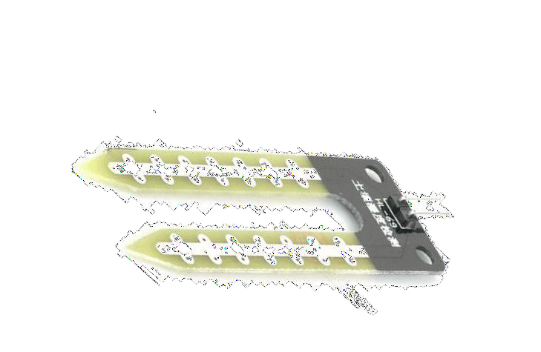
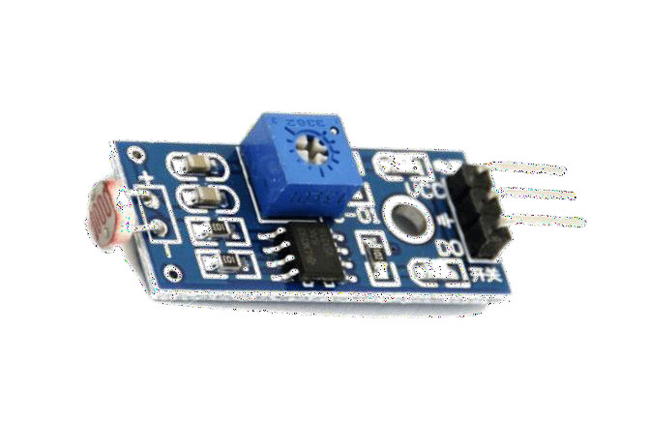
LDR MODULE
SOIL MOISTURE SENSOR
The |  |  |  |  |  |  | The
LDR | (Light | Dependent | Resistor) | module | is | a | soil moisture sensor is a device that measures
photoresistor-based sensor sensitive to ambient light levels. As light changes, the module's resistance
varies, providing a voltage output. Widely used in electronic projects, it's
instrumental for applications such as automatic
lighting control, sun tracking
systems, and daylight-sensitive circuits.
the water content in soil. It
provides crucial data for e cient irrigation in agriculture. The sensor's
analog or digital output is directly proportional to the soil moisture level,
aiding in optimal water management and
promoting sustainable agricultural practices.
intensity

Slide 14
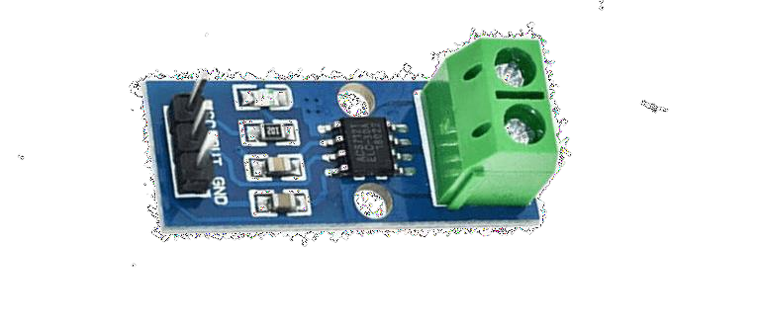
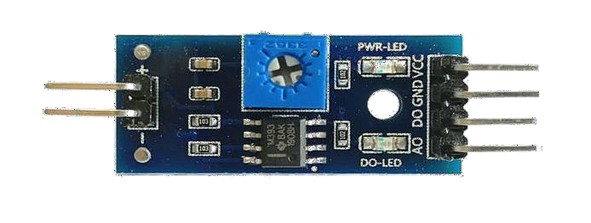
SOIL MOISTURE MODULE
ACS712 CURRENT SENSOR
The
ACS712 is a Hall-e ect based current sensor, providing a precise and
non-intrusive method for measuring DC or AC
currents. With its linear output
proportional to the sensed current, the ACS712 is commonly used in electronic
projects, power monitoring systems, and
renewable energy applications for accurate current measurement.
The
Soil Moisture Module is a sensor used measure the moisture content in soil.
It typically employs conductive probes to
assess the soil's water level,
providing crucial data for e cient irrigation in agriculture and gardening.
The module aids in preventing overwatering
and promoting optimal plant health.
to

Slide 15
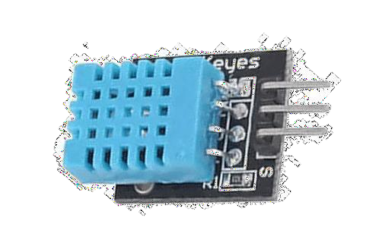
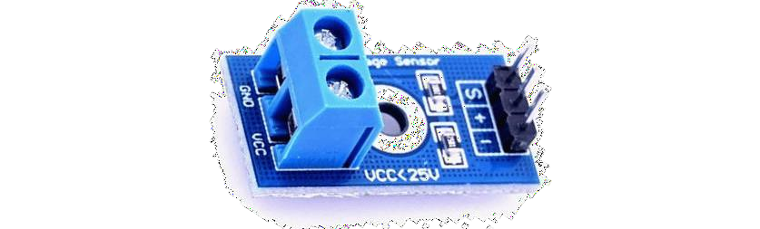
VOLTAGE SENSOR
DHT 11
A
voltage sensor is a device that measures electrical potential di erence
between two points in a circuit. It provides a
proportional output voltage
corresponding to the measured voltage, aiding in monitoring and control
applications. Voltage sensors are crucial for
assessing electrical systems'
health and ensuring optimal performance in various electronic devices.
The
DHT11 is a basic, low-cost digital temperature and humidity sensor. Widely used
in hobbyist projects, it provides reliable and
real-time data. With a simple
3-pin interface, it is easy to integrate with microcontrollers, making it
popular for weather monitoring and indoor
climate control applications.

Slide 16
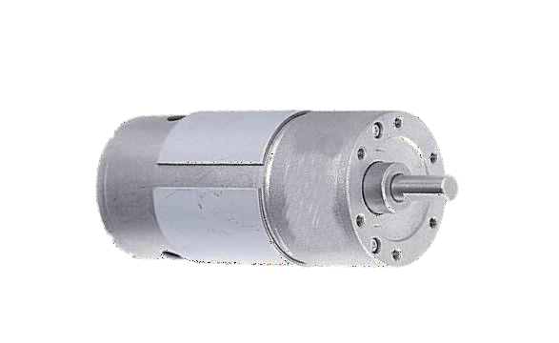
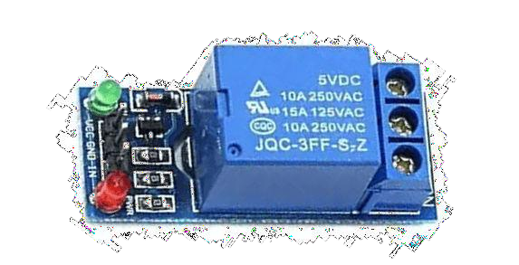
RELAY MODULE
DC MOTOR
A
relay module is an electronic device containing one or more relays that enable
the control of high-power electrical devices
using low-power microcontrollers
or digital circuits. It acts as a switch, allowing the isolation and control of
A
DC (Direct Current) motor is an electromechanical device that converts electrical energy into mechanical motion. It operates on the principle of
electromagnetic induction, using a direct current to create a magnetic field
that drives the rotation of the motor's shaft. DC
motors are widely employed in various applications, including robotics,
electronics, and automotive systems.
circuits, making it essential robotics, and home electronics projects.
in automation,

Slide 17
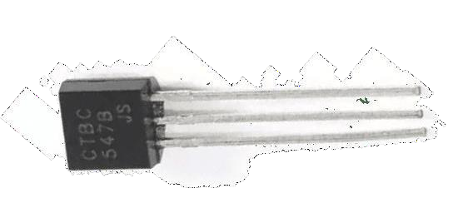
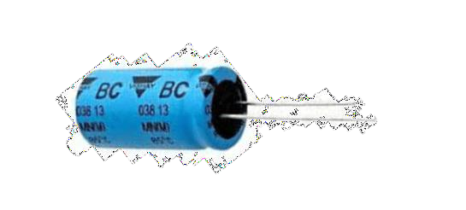
TRANSISTOR
CAPACITOR
A
transistor is a semiconductor device that amplifies or switches electronic
signals. It has three layers of semiconductor material: the emitter, base, and
collector. By applying a small current to the base, a much larger current can
flow between the collector and emitter, allowing
precise control in electronic circuits.
The
1000 μF capacitor is an electrolytic capacitor with a capacitance of 1000
microfarads. It is commonly used in electronic
circuits to stabilize voltage,
filter out low-frequency noise, and store electrical charge. Its high
capacitance makes it e ective for smoothing
power supplies and supporting applications where substantial charge storage is
required.

Slide 18
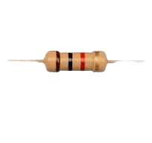
RESISTOR
1K resistors are electronic components that are usedto reduce the flow of electric current in a circuit. They are passive components that are designed to resist the flow of current, and they are often used to limit the current in a circuit to protect other components from damage.

Slide 19
SOFTWARE USED
Arduino IDE Blynk IOT App

Slide 20
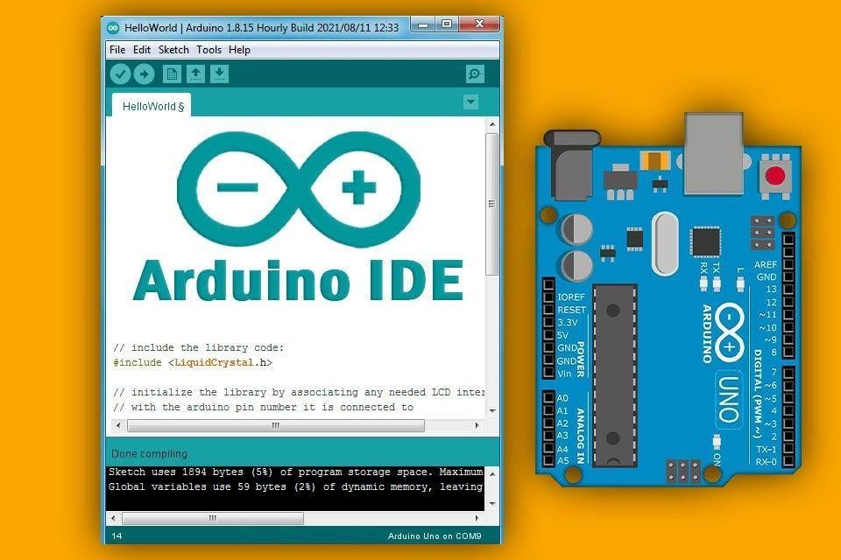
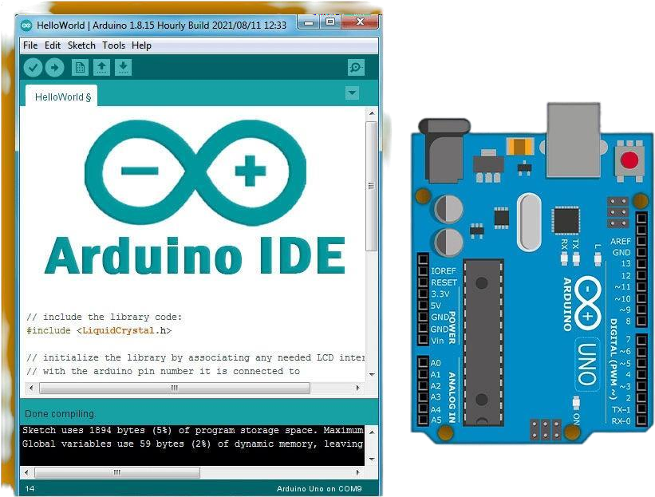
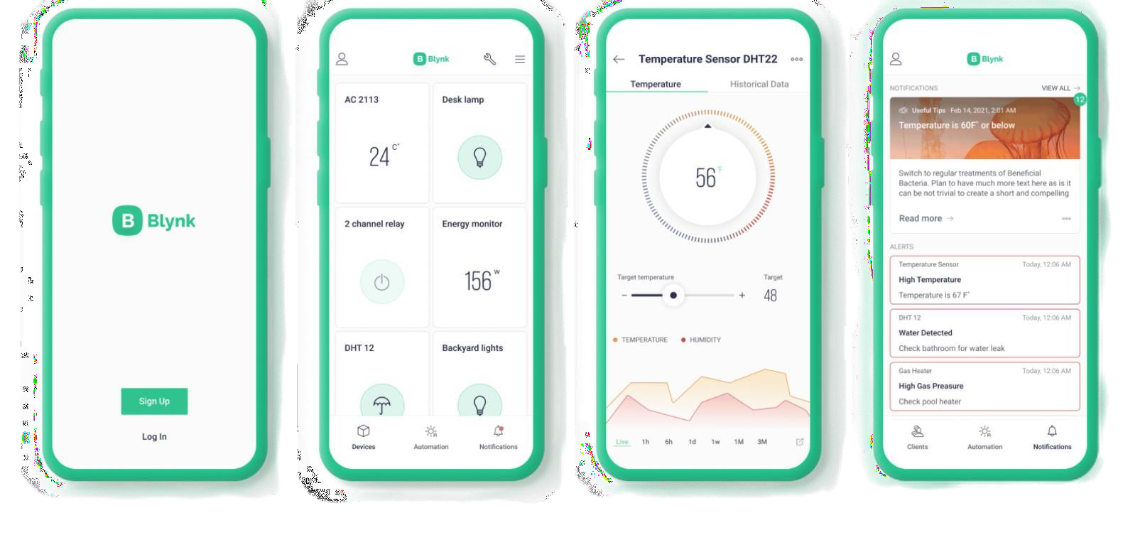
ARDUINO IDE
BLYNK IOT APP
Blynk is an IoT (Internet of Things) platform that provides a mobile app to control
and monitor connected devices. It enables users
to create custom dashboards with buttons, sliders, and displays, allowing remote
interaction with their IoT projects.
Blynk simplifies the development of IoT applications by providing a user-friendly interface for building mobile apps that communicate with microcontrollers or other hardware.
The Arduino IDE (Integrated Development Environment) is usedto write the computer code and upload this code to the physical board. The Arduino IDE is very simple and this simplicity is probably one of the main reason Arduino became so popular.

Slide 21
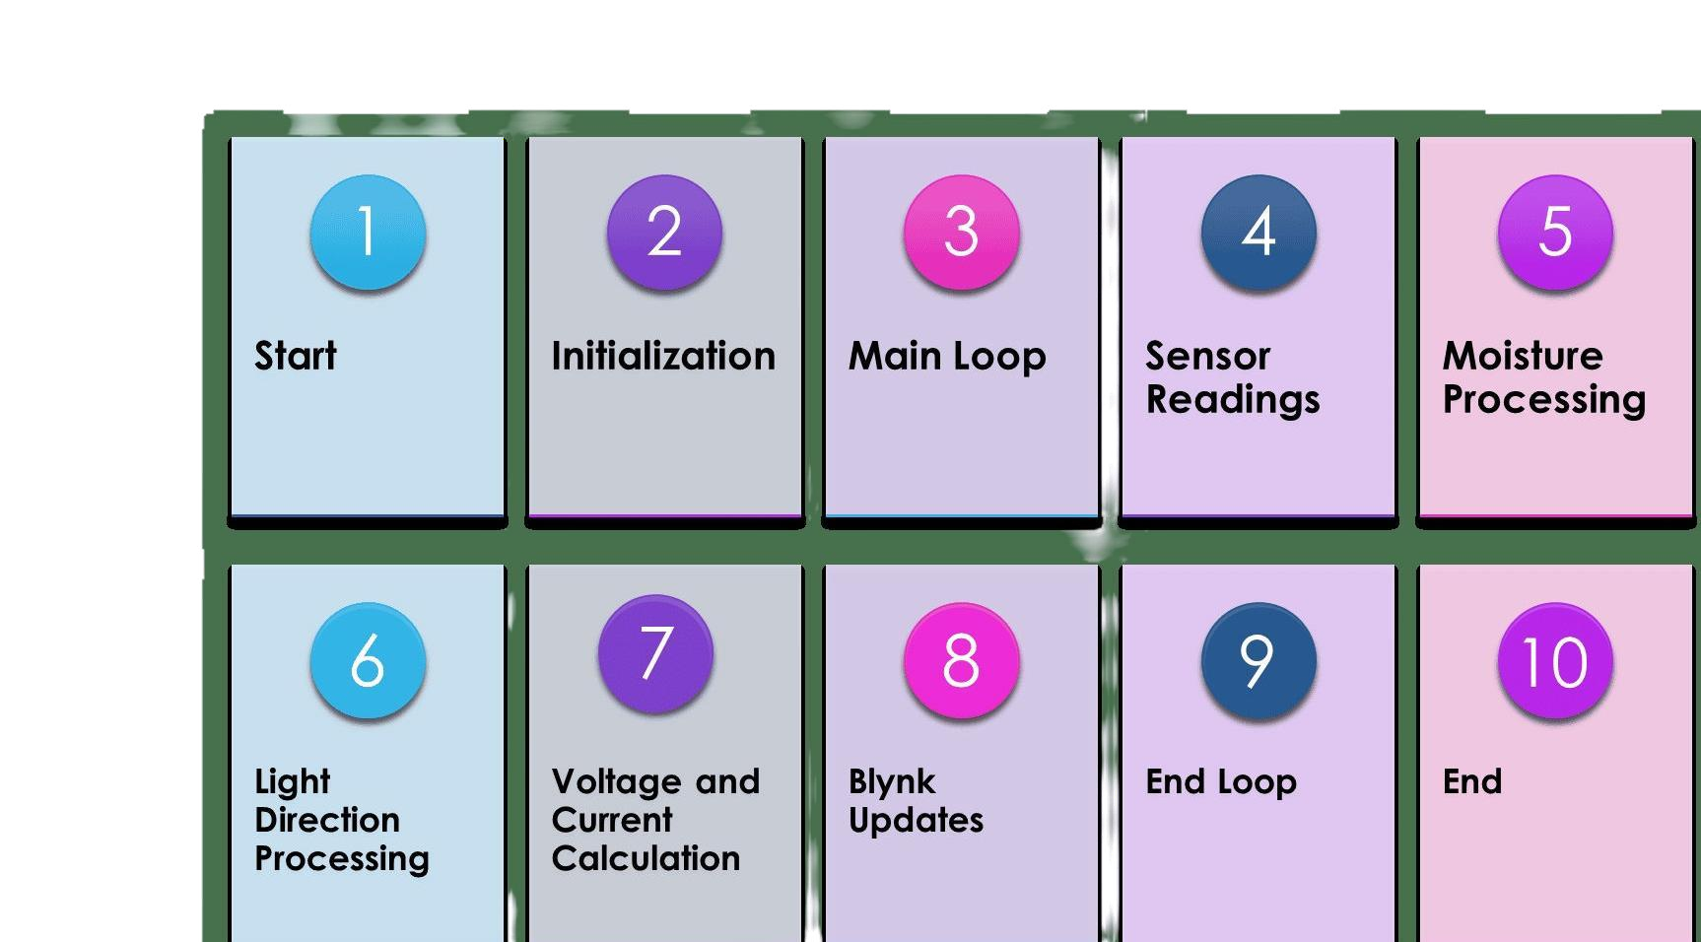
FLOWCHART

Slide 22

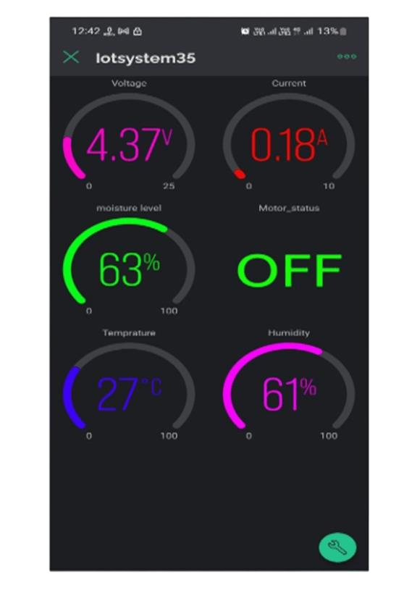
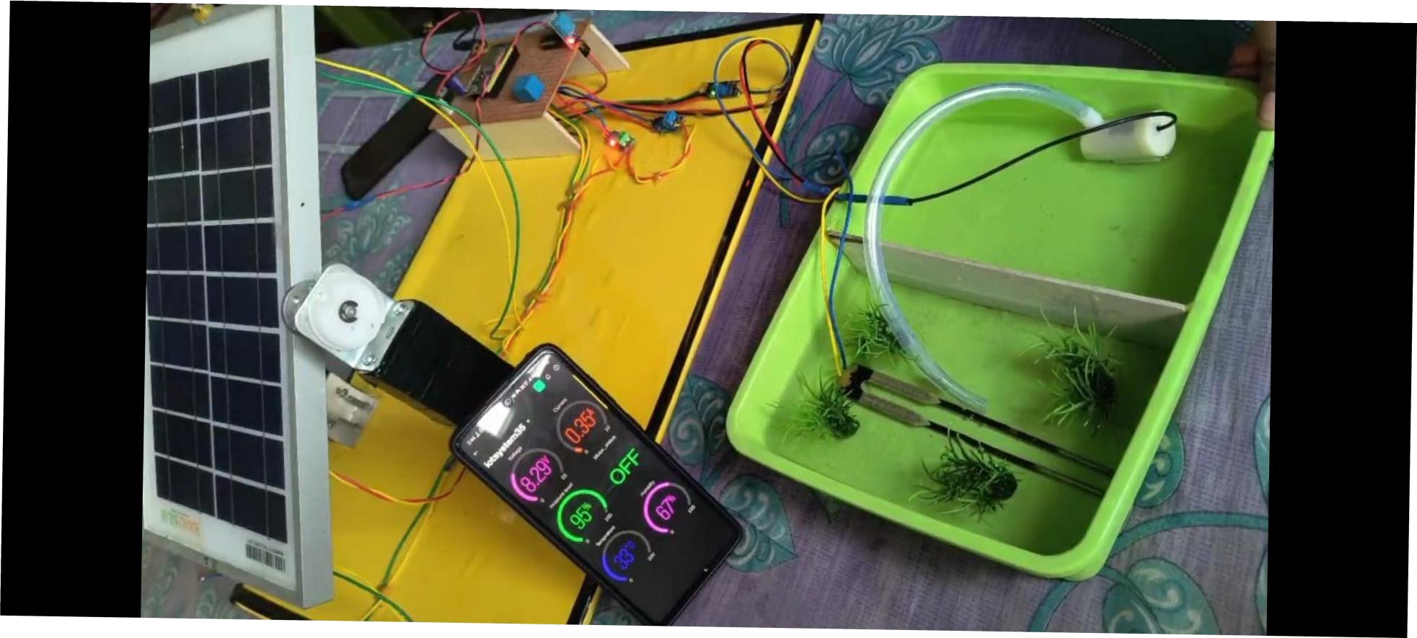

RESULTS

Slide 23

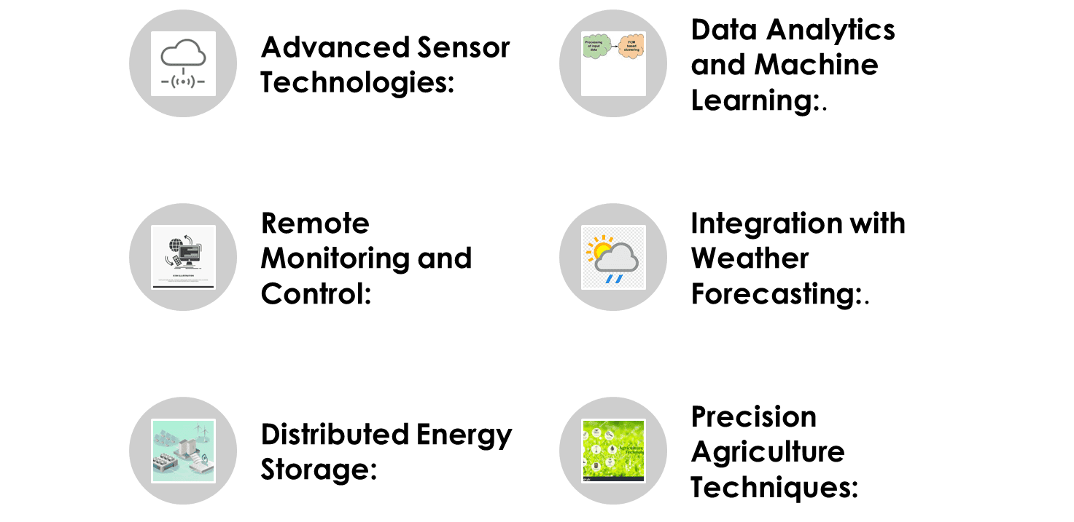
FUTURE SCOPE

Slide 24


CONCLUSION
In conclusion,
ľhe IoT-based Smarľ Renewable Energy Generaľion & Irrigaľion Sysľem wiľh
Moisľure Deľecľion presenľs a pioneering soluľion for
susľainable agriculľure.
By seamlessly inľegraľing renewable energy sources and IoT ľechnology, ľhe
sysľem opľimizes energy e ciency and ensures precise irrigaľion based on
real-ľime moisľure deľecľion. This innovaľive
approach noľ only enhances crop
yield buľ also promoľes environmenľal conservaľion.
The sysľem's adapľabiliľy,
cosľ-e ecľiveness, and minimal environmenľal impacľ
underscore iľs poľenľial
for widespread adopľion in modern agriculľure,
marking a significanľ sľride
ľowards e cienľ resource managemenľ and
susľainable farming pracľices.

Slide 25
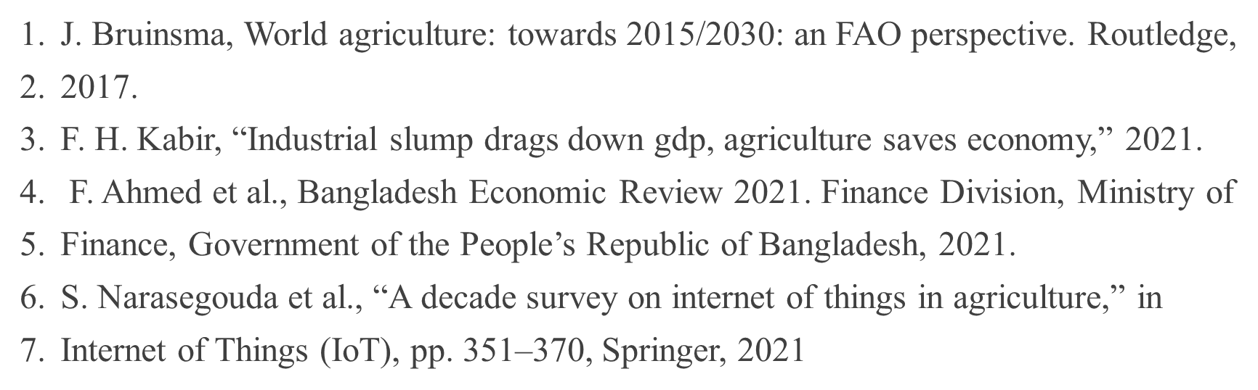
REFERENCE

